Slide 1
IMAGE SCRAPING AND CLASSIFICATION PROJECT

Slide 2
PROBLEM STATEMENT:
Images are one of the major sources of data in the field of data science and AI. This field is making appropriate use of information that can be gathered through images by examining its features and details. We are trying to give you an exposure of how an end to end project is developed in this field.
The idea behind this project is to build a deep learning-based Image Classification model on images that will be scraped from e-commerce portal. This is done to make the model more and more robust.

Slide 3
UNDERSTANDING:
From the words Image classification, it analyzes images with their AI-based Deep Learning power, the models that can be identify and recognize a wide variety of criteria. It is a term to describe a set of algorithms and technologies that attempt to analyze images and understand the hidden representations.

Slide 4
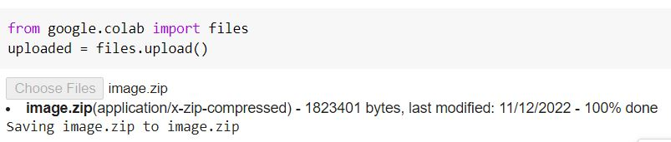
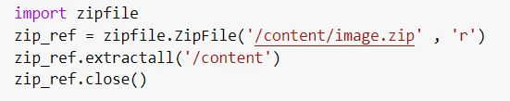
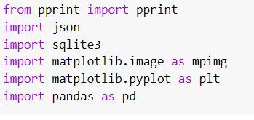
STEP 1:
STEP 2:

Slide 5
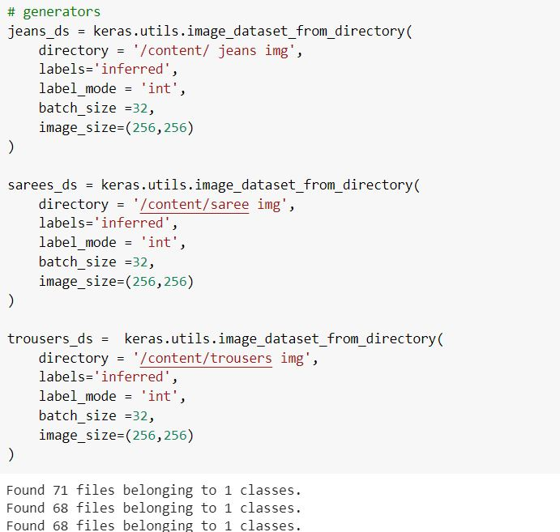
STEP 3:

Slide 6
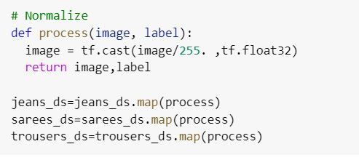
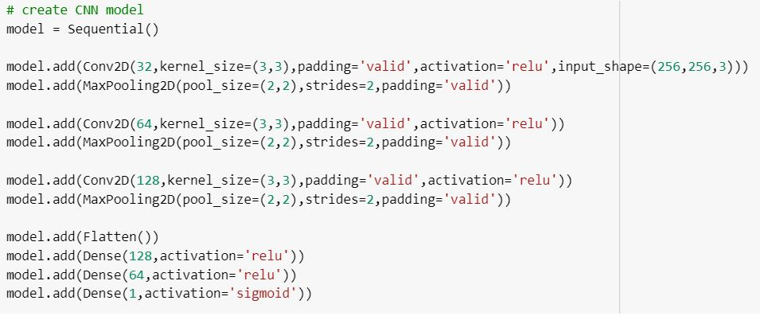
STEP 4:
STEP 5:

Slide 7
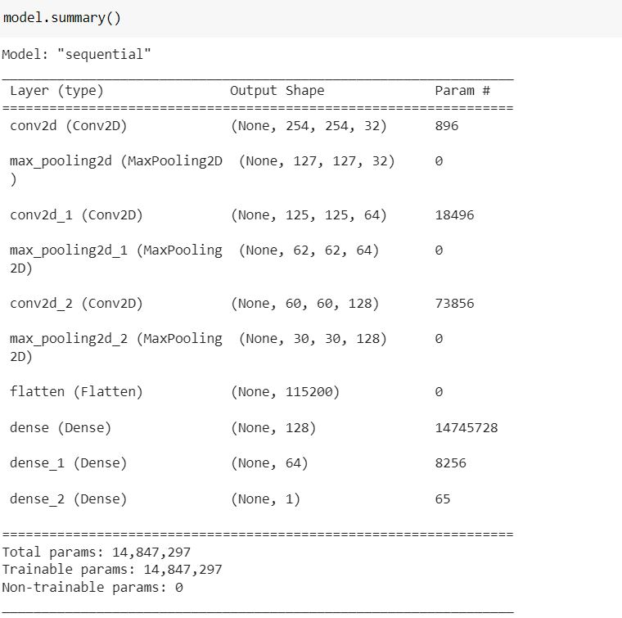
STEP 6:

Slide 8
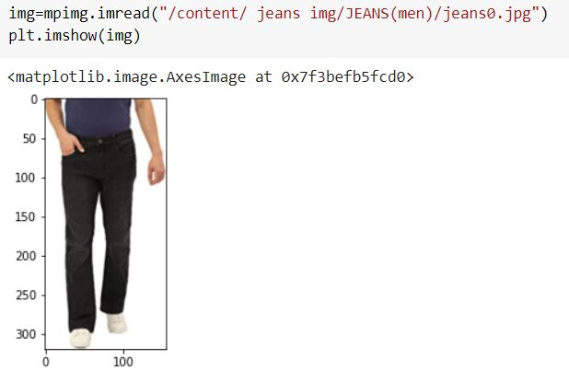
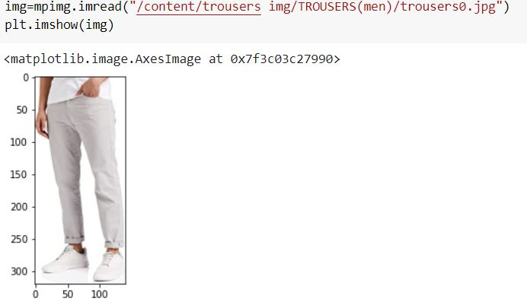
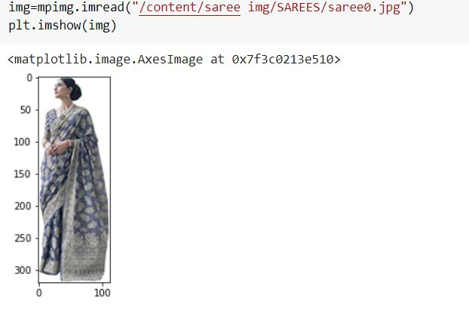
SAMPLE OF IMAGES

Slide 9
STEPS AND ASSUMPTIONS TO COMPLETE THE PROJECT:
A human analyst attempting to classify features in an image uses the elements of visual interpretation.
Deep Learning using Convolutional Neural Network (CNN) which is reputable for working with images.
Image classification is a subset of image recognition which has widespread use in the security industry (facial recognition), virtual search engine (object finder in stores), healthcare (emotion detection in patients) and gaming and augmented reality.
The purpose of this project to make an exposure of how an end to end project is developed in this field.
The task is divided into two phases: Data Collection and Model Building.

Slide 10
CONCLUSION
In conclusion, combining the formerly know the datasets analyze and to improve the model building. This assignment is all about the subset of image recognition which has widespread use in the security industry (facial recognition), virtual search engine (object finder in stores), healthcare (emotion detection in patients) and gaming and augmented reality. In a way, smartphone cameras have made all these advances possible with multitudes of pictures that can be easily created.

Slide 11
THANK YOU

